Slide 1
Gloss management for consistent reproduction of real and virtual objects
Bin Chen, Michal Piovarči, Chao Wang, Hans-Peter Seidel, Piotr Didyk, Karol Myszkowski, Ana Serrano
sa2022.siggraph.org

Slide 2
Gloss consistency matters
sa2022.siggraph.org

Slide 3
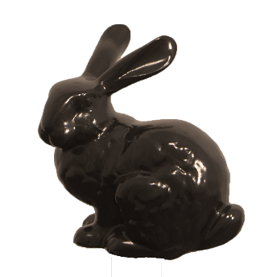
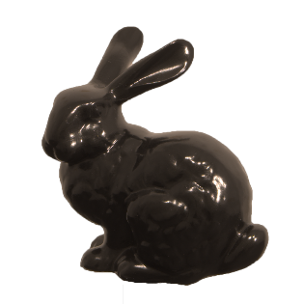
Discrepancy between real world and display
Appearance
=?
Real object
Displayed version
sa2022.siggraph.org

Slide 4
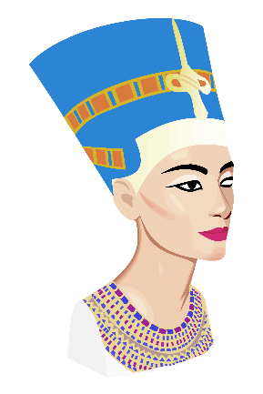
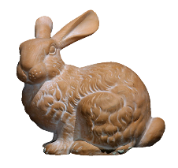
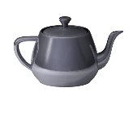
Discrepancy between real world and display
Same appearance as real object?
sa2022.siggraph.org

Slide 5
Discrepancy between real world and display
different?
Same appearance as I designed?
sa2022.siggraph.org

Slide 6
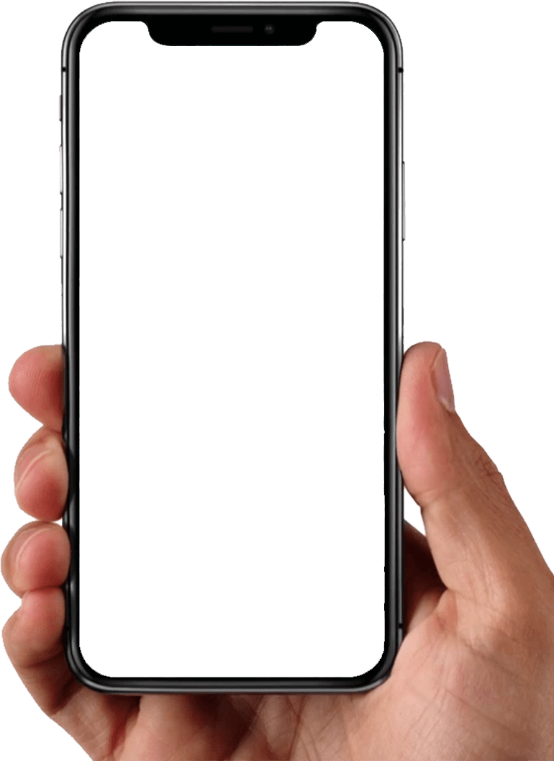
Discrepancy between real world and display
Same appearance if I buy it?
sa2022.siggraph.org

Slide 7
Gloss consistency matters
Color and Gloss
Resolution
Contrast
Stereo
Motion parallax
Accommodation
sa2022.siggraph.org

Slide 8
Gloss consistency matters
Color and Gloss
Color consistency
[Brunton et al. 2015]
[Fairchild 2013]
[Sumin et al. 2019]
Gloss consistency?
Gloss consistency matters
sa2022.siggraph.org

Slide 9
Goal and contributions
Goal:
A step-forward to understand the gloss discrepancy
between real object and its displayed counterpart.
Contributions:
Experiment considering geometry, illumination, and display brightness
Analysis of collected data
Correction that compensates for the gloss discrepancy.
Applications in fabrication
sa2022.siggraph.org

Slide 10
Experiments
sa2022.siggraph.org

Slide 11
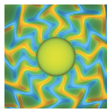
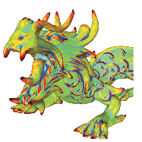
Stimuli (Geometry)
Typical geometries in CG community
Geometries optimized for perception study
Cover large range of geometry surface features
[Havran 2016]
[Serrano 2021]
[Serrano 2021] The effect of shape and illumination on material perception: model and applications
sa2022.siggraph.org

Slide 12
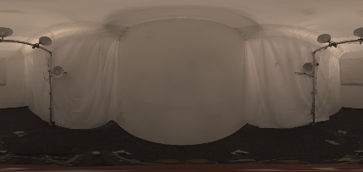
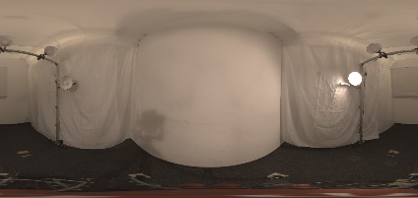
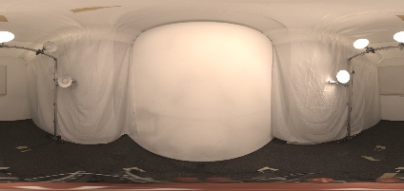
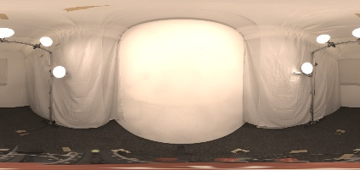
Stimuli (Illumination)
Diffuser
Light sources
Panorama
Diffuse
One spotlight
Three spotlights
Five spotlights
sa2022.siggraph.org

Slide 13
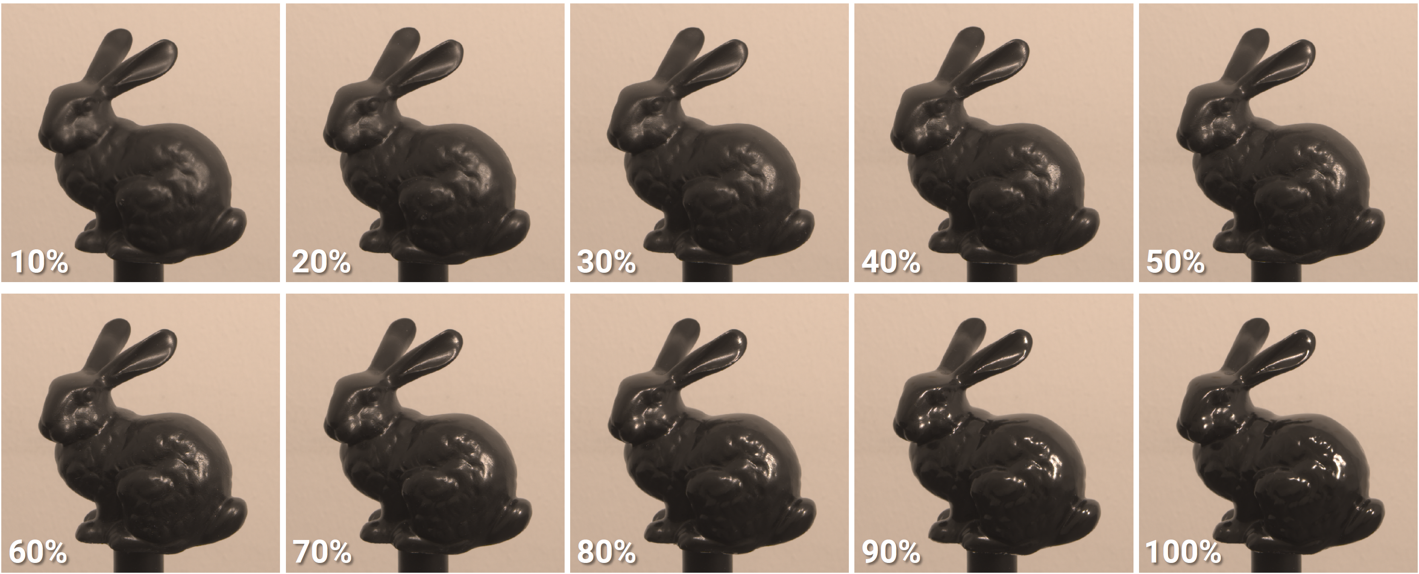
Stimuli (Gloss levels)
glossy
matt
Varnishing procedure
mix varnishes
dipping
airdry
Varnishing results
sa2022.siggraph.org

Slide 14
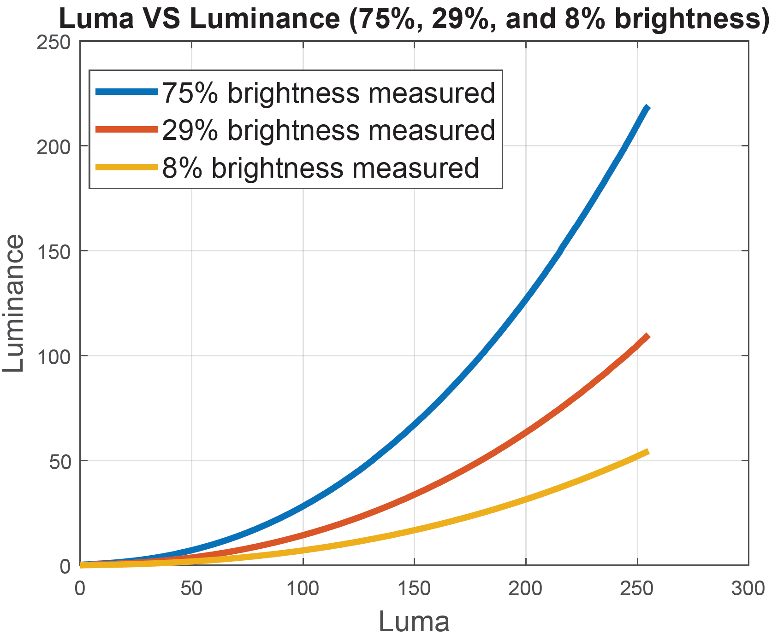
Stimuli (Display brightness)
bright
medium
dark
75%
29%
8%
$$γ≈2.24$$
220 cd/m²
110 cd/m²
55 cd/m²
Office, daytime
Nighttime
Cinema
Gamma-Offset-Gain (GOG) display model
Display surface reflection
sa2022.siggraph.org

Slide 15
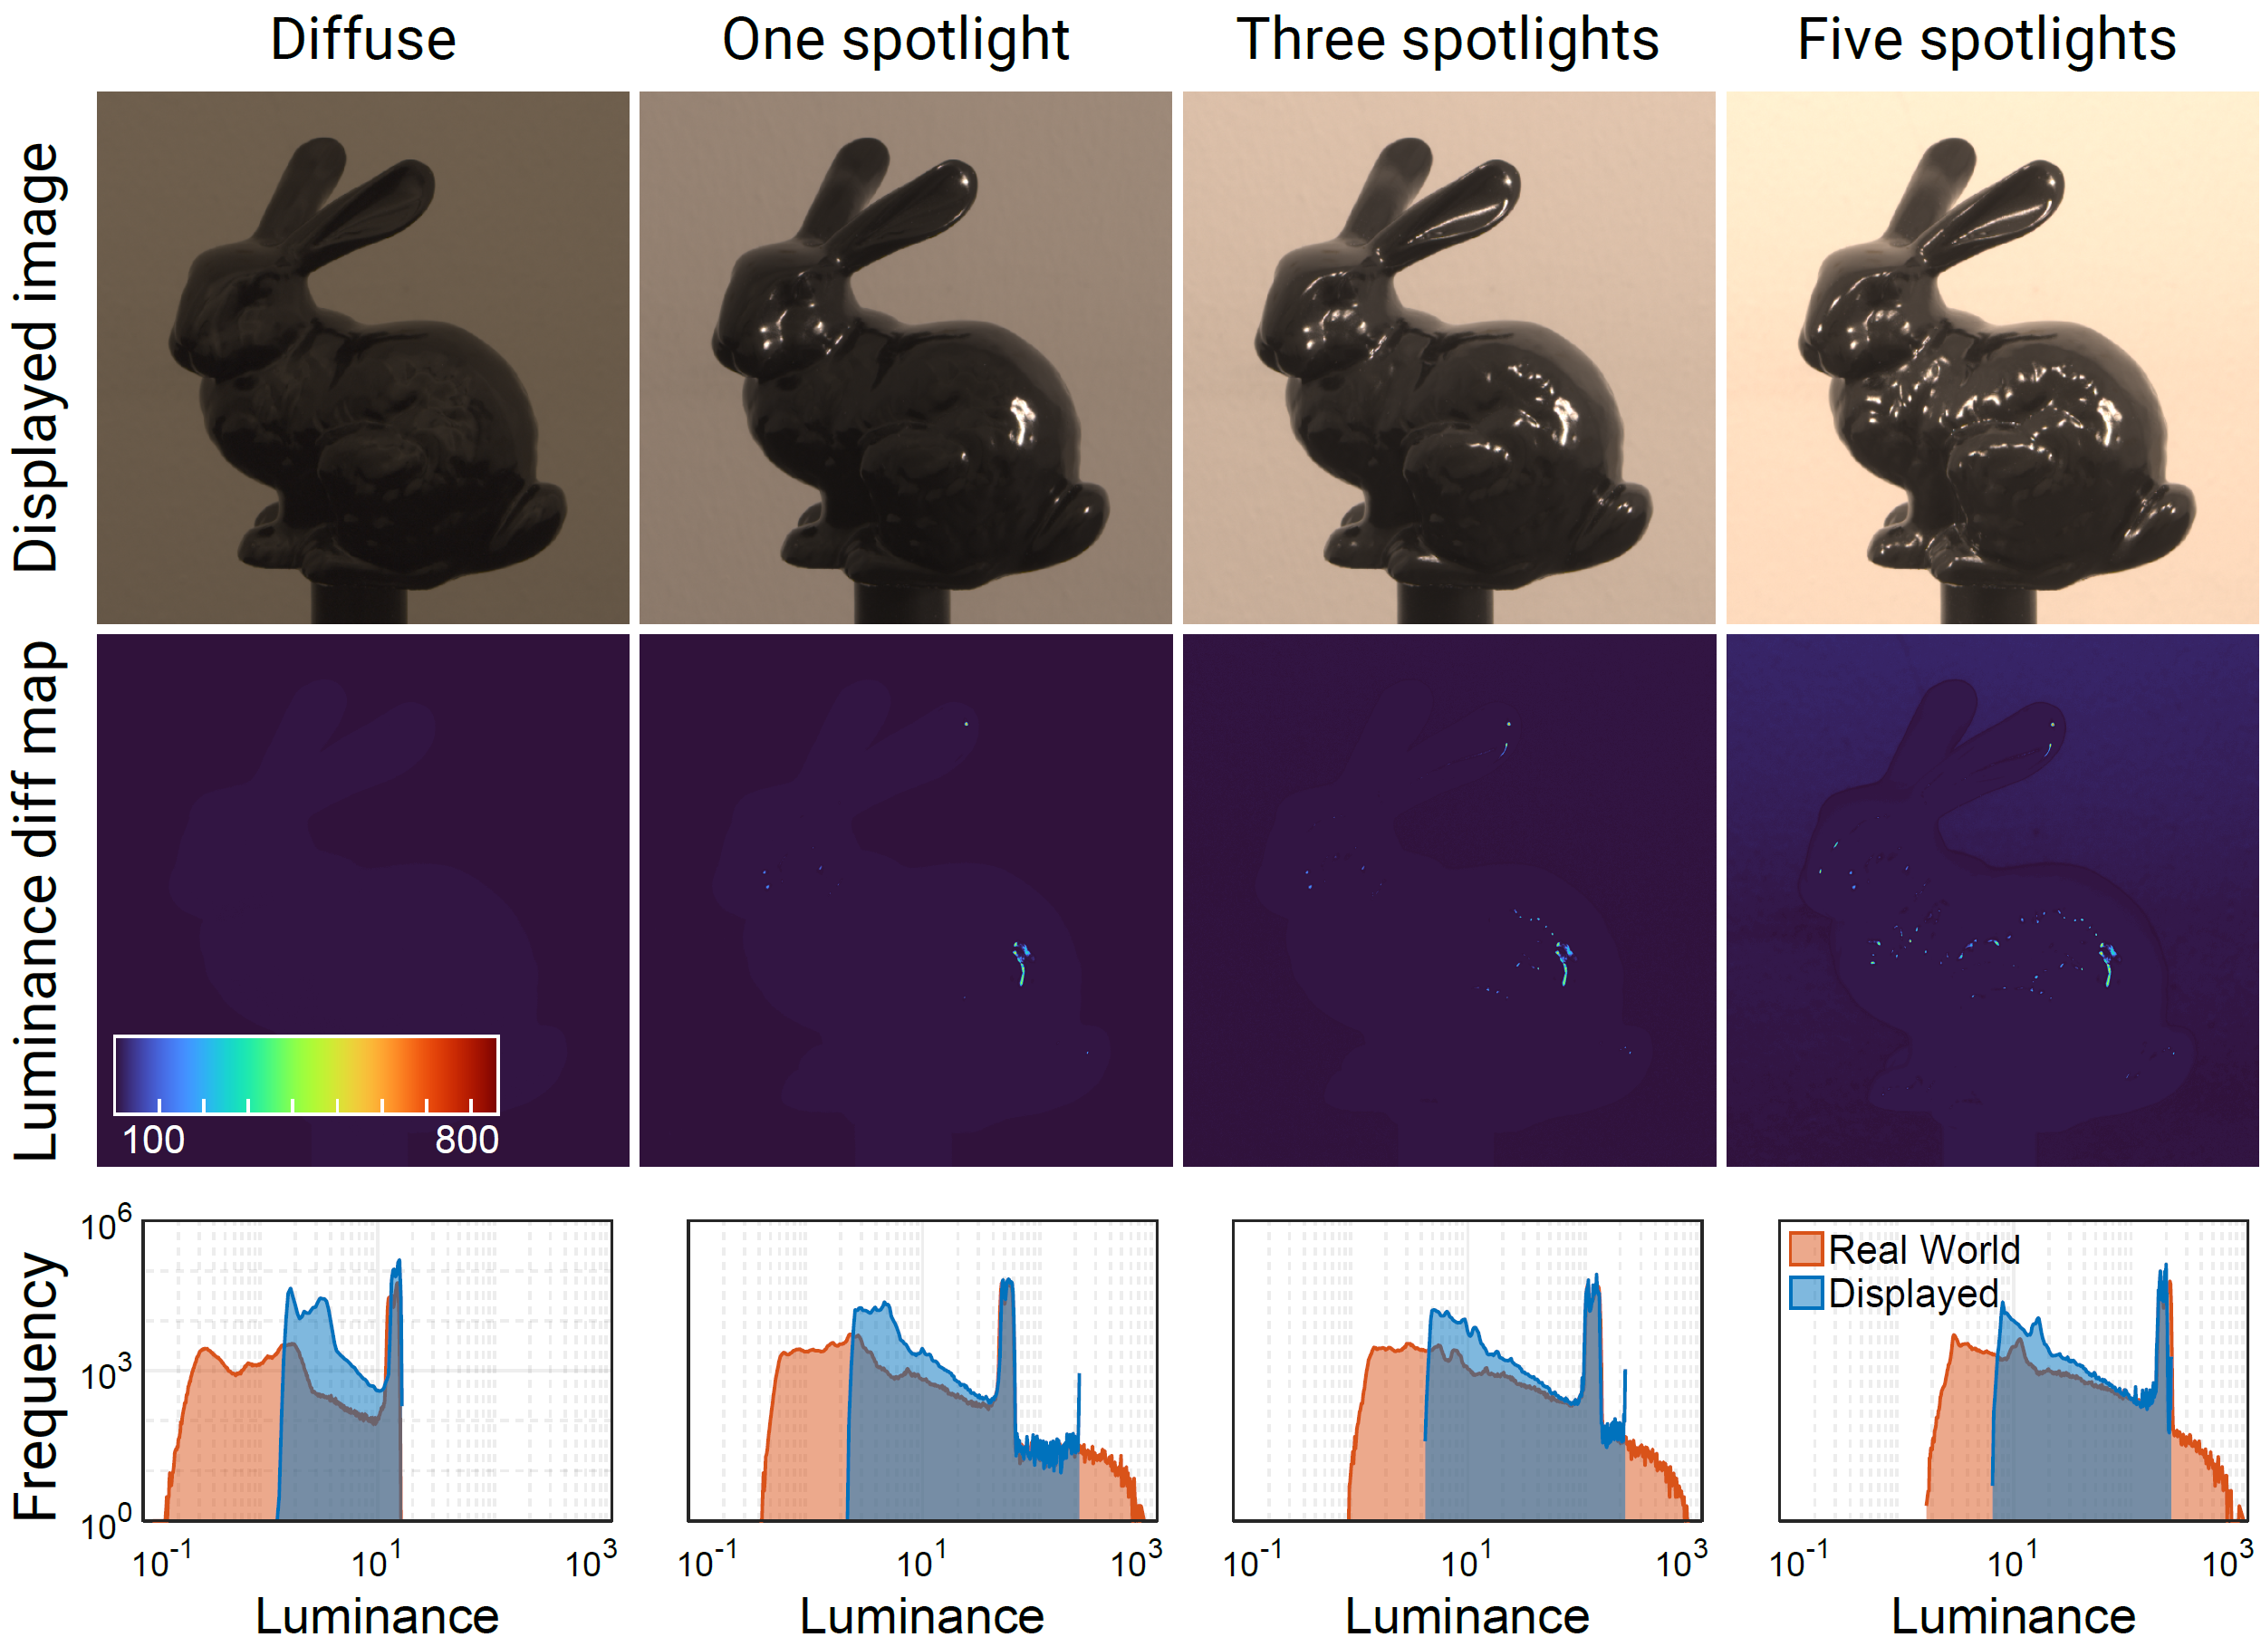
Stimuli
Photo captured in
13 exposures
Fuse to HDR image
Chromatic adaption to 4000 K
Gamma correct HDR to LDR
based on GOG model
Pixel level luminance match
sa2022.siggraph.org

Slide 16
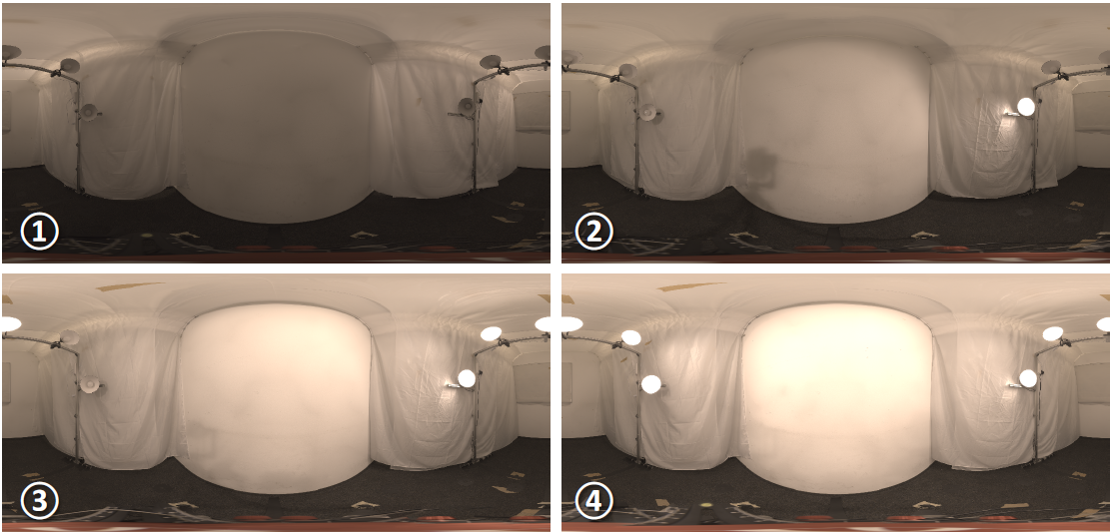
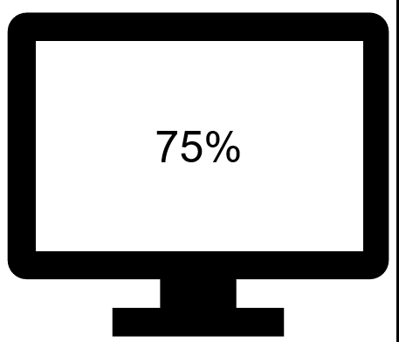
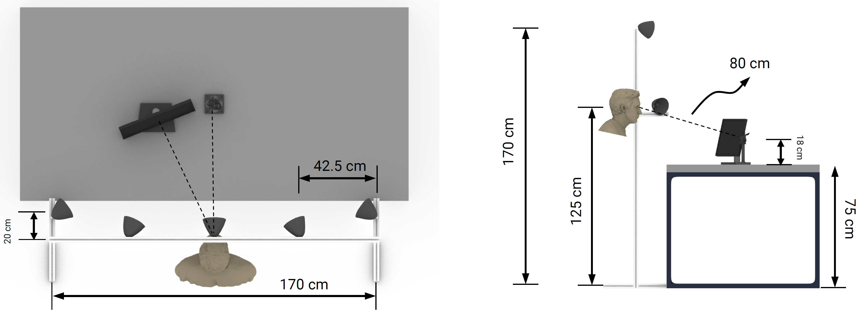
Psychophysical experiments
160
trials
4
geometries
4
illuminations
10
glossiness
1
random
brightness
View distance: 80 cm
Display surface perpendicular to line of sight
42 participants, 20 female
19 ~ 34 years old
sa2022.siggraph.org

Slide 17
Psychophysical experiments
Experiment simulation
Experiment real
sa2022.siggraph.org

Slide 18
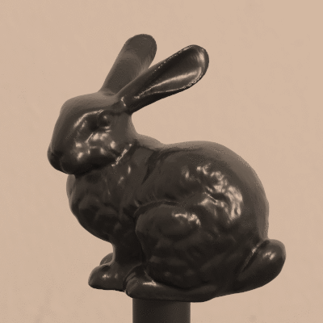
Psychophysical experiments
Match experiment
Adjust gloss of
displayed version
Real object
sa2022.siggraph.org

Slide 19
Data analysis
sa2022.siggraph.org

Slide 20
Data analysis
Multinomial logistic regression model
2nd poly fit
Factors: illumination, geometry, display brightness and their interaction
Nagelkerke pseudo R-square
$$R^{2}=0.87$$
All factors have significant effect as well as their interactions ($p<0.001$)
sa2022.siggraph.org

Slide 21
Effect of geometry
V10 – V100: varnish mixture/gloss levels
D10 – D100: displayed gloss levels
Diagonal: ideal GT
sa2022.siggraph.org

Slide 22
Effect of geometry
Geometry:
Bunny, Ghost, Blob behave as a group
Dragon is different from others
sa2022.siggraph.org

Slide 23
Effect of display brightness
Display brightness:
Dark > Medium > Bright
in terms of needed correction
8%
29%
75%
sa2022.siggraph.org

Slide 24
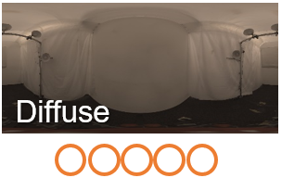
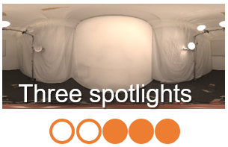
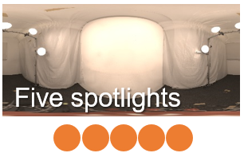
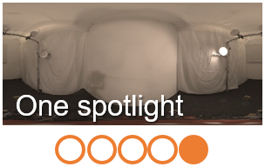
Effect of illumination
Illumination:
diffuse needs very large correction
one spotlight needs smallest correction
three spotlights and five spotlights similar
sa2022.siggraph.org

Slide 25
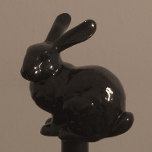
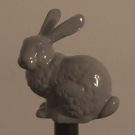
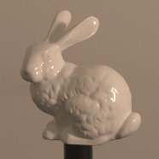
Experiment on lightness
Correction on diffuse light decreases with lightness increase
White needs more correction under one spotlight
Black (Pantone Hexachrome Black U)
Gray (Pantone Cool Gray 8U)
White (Pantone White U)
sa2022.siggraph.org

Slide 26
Applications
sa2022.siggraph.org

Slide 27
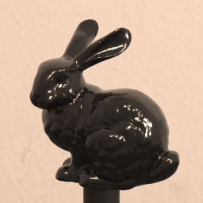
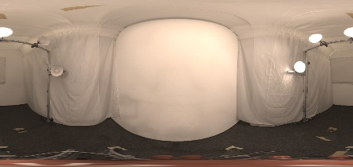
Digital product design
glossy
matt
mix varnishes
Geometry
Illumination
BRDF
Rendered
Corrected
varnish proportion
varnish mixture
sa2022.siggraph.org

Slide 28
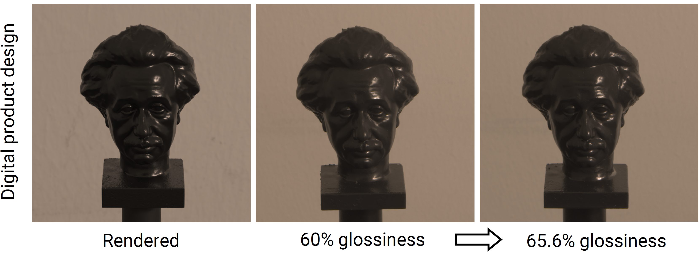
Digital product design
Illumination: One spotlight
Display: 75% brightness
Glossiness: 60%
sa2022.siggraph.org

Slide 29
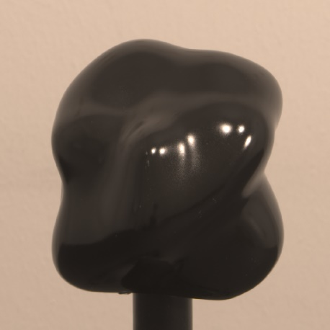
Digitizing physical artifacts
Scan geometry
Fit BRDF
Capture illumination
Real varnished object
sa2022.siggraph.org

Slide 30
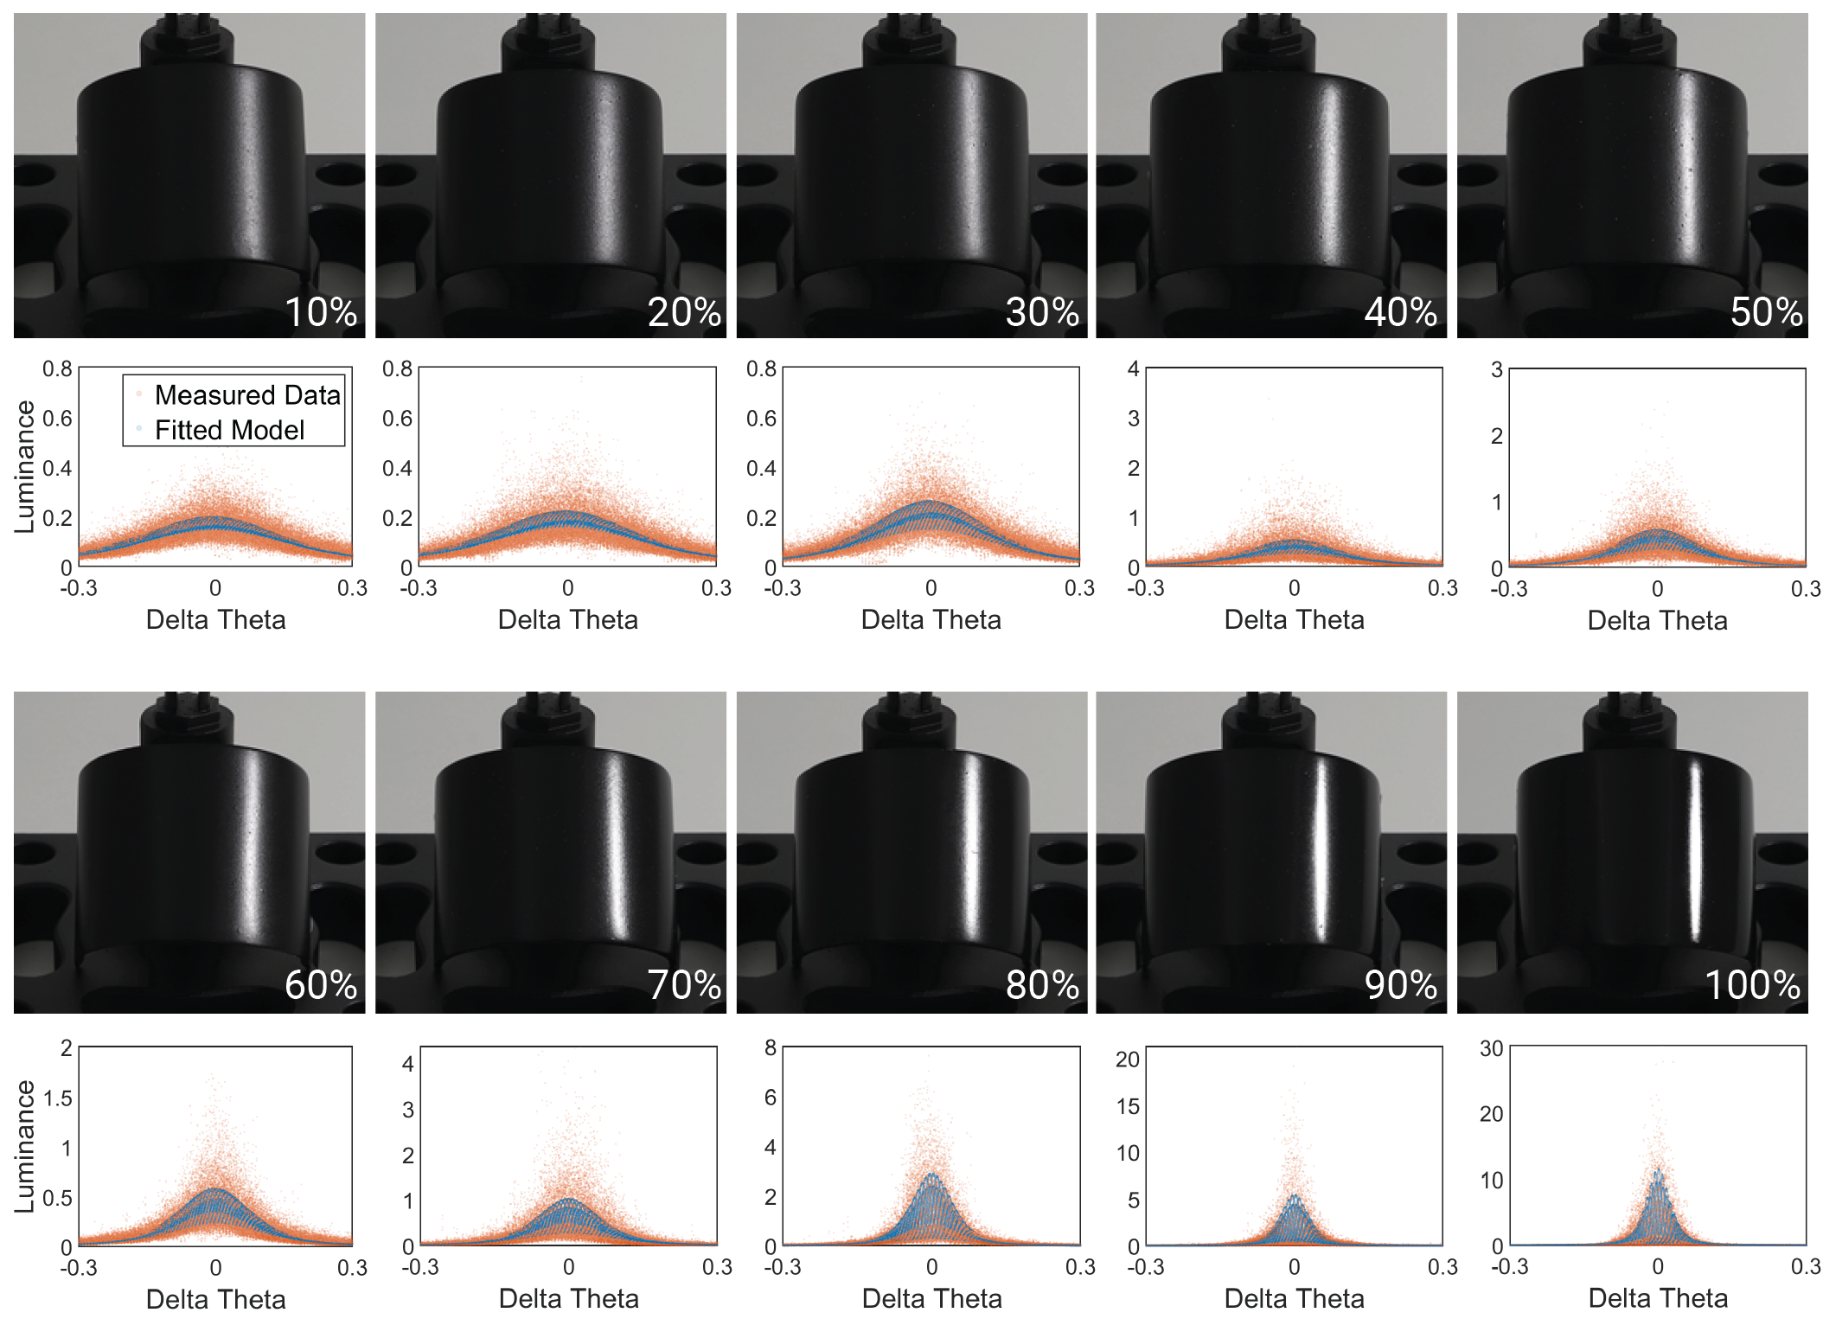
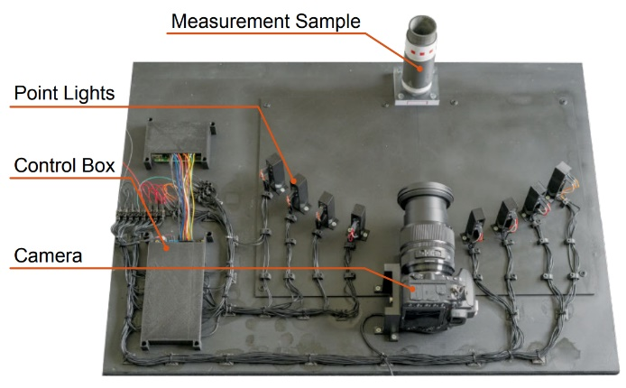
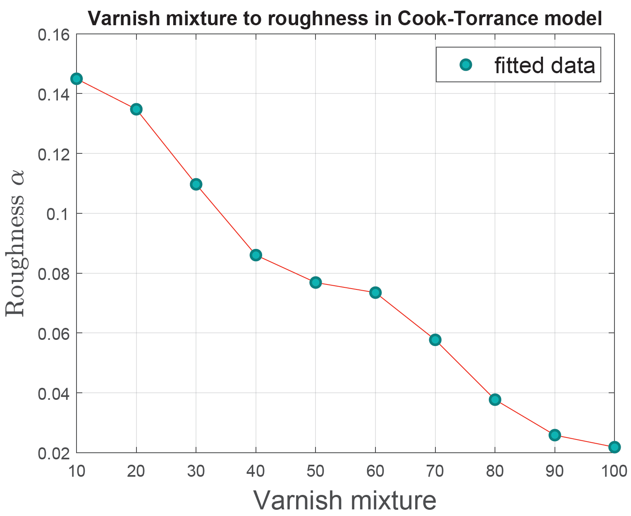
Digitizing physical artifacts
Measure BRDF of another oil-based varnish
Fit to Cook-Torrance model with GGX distribution
sa2022.siggraph.org

Slide 31
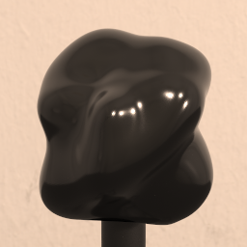
Digitizing physical artifacts
Scan geometry
Fit BRDF
Capture illumination
gloss
REAL
Real varnished object
Render to display
sa2022.siggraph.org

Slide 32
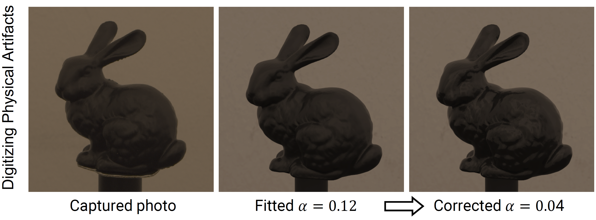
Digitizing physical artifacts
This is logically not possible to confirm anything without seeing real object
Come to interactive discussion session for details
sa2022.siggraph.org

Slide 33
Conclusion
sa2022.siggraph.org

Slide 34
Limitations & Future work
Limitations
Currently, experiment only on LCD monitor (LDR, 1000:1) in office scenario on plastic.
Future work
HDR (MiniLED, OLED)
Metal
Reflective monitor
Stereoscopic
sa2022.siggraph.org

Slide 35
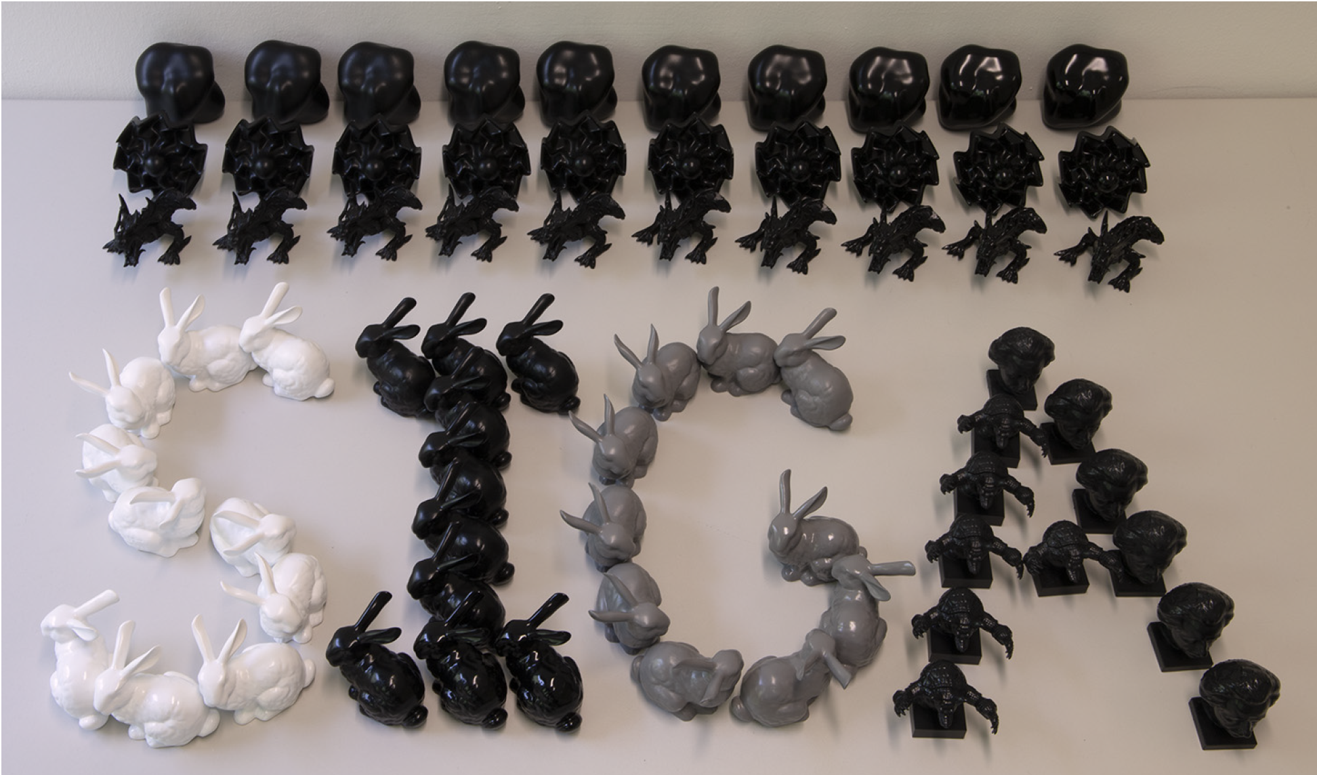
Conclusion
First step
to gloss consistency
Experiment
Analysis
Correction
Applications
glossmanager.mpi-inf.mpg.de
sa2022.siggraph.org

Slide 36
Thank you!
sa2022.siggraph.org

Slide 37
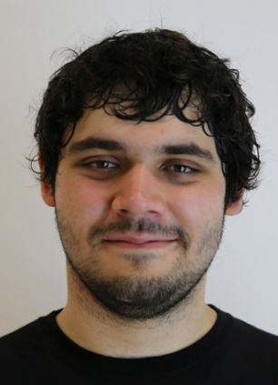
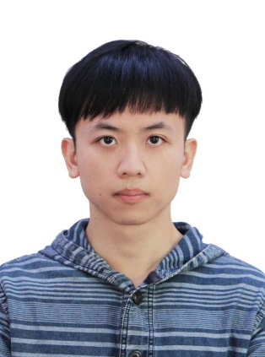
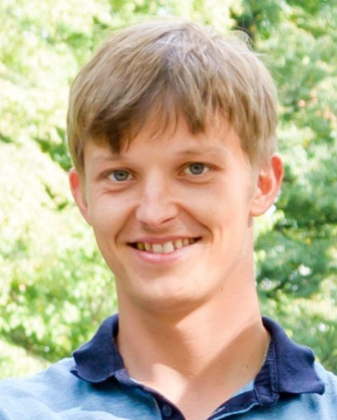
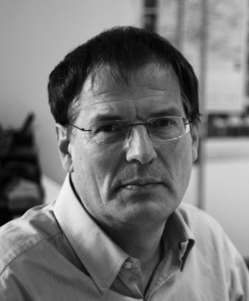
Authors
Bin Chen
Michal Piovarči
Chao Wang
Hans-Peter Seidel
Piotr Didyk
Karol Myszkowski
Ana Serrano

